Slide 1
SHA-1
By Kamila Hasanbega
Secure and Dependable Systems – Spring 2017

Slide 2
What is this presentation about?
Hash Functions and Cryptographic Hash Functions
Properties of the ideal Cryptographic Hash Function
Simple Hash Function
What is SHA?
Usage of SHA-1
SHA1: Properties
Let’s try it out (SHA1 Example)
Crypto behind SHA-1
Other Versions
Limitations and cryptanalysis
1st Generated SHA-1 Collision
What is a cryptographic hash collision?
Who is affected?
Who is capable of mounting this attack?
Finding SHA-1 Collisions
Mitigating collision attacks
Q&A
Bibliography

Slide 3
Hash Functions and Cryptographic Hash Functions
Cryptographic hash function H ∶ {0, 1} ∗ → {0, 1} n : function that computes for any arbitrarily long message M a fixed-length hash value of n bits.
Main property: it is very difficult to find two different messages that produce the same message digest. Two distinct messages that result in the same digest are called collisions. (J. E. Sivla, 2005)
Applications in Information Security and ordinary hashing:
Digital Signatures
Message authentication codes (MACs)
Indexing Hash Tables
Fingerprinting
Detecting duplicate data
Checksums- detect data corruption

Slide 4
Properties of the ideal Cryptographic Hash Function
Deterministic - the same message always results in the same hash
Fast - quick to compute the hash value for a given message
Infeasible to generate a message from its hash value (except by trying all possible messages)
Small change to a message changes the hash value so extensively that the new hash value appears uncorrelated with the old hash value
Infeasible to find two different messages with the same hash value
Hashes are "digests", not "encryption”.

Slide 5
What is SHA?
SHA - Secure Hash Algorithm – cryptographic hash function
Versions of SHA:
SHA-0
SHA-1
SHA-2
SHA-3
SHA1
Cryptographic Hash function designed by the US National Security Agency (NSA) and NIST.
U.S. Federal Information Processing Standard
Upon given a message, SHA1 produces a message digest of 160 bits (rendered as 40 digits decimal number)
Notes:
SHA-1 is a hashing function, which produces a digital fingerprint from a given file. That lets you verify a file’s integrity without exposing the entire file, simply by checking the hash. If the hash function is working properly, each file will produce a unique hash — so if the hashes match, the files themselves will also match. That’s particularly important for login systems, which need to verify that a password is correct without exposing the password itself.
---
As recently as 2014 it was being used for as much as 90 percent of the encryption on the web, but it’s been mostly abandoned in the years since.

Slide 6

Usage of SHA-1
Used for digital signatures, file integrity verification and to protect digital assets as credit card transactions, electronic documents, open-source software repositories and software updates.
No Longer Secure!
Collisions found.
Applications (Security applications and protocols)
TLS
SSL
PGP
SSH
S/MIME
IPsec
Applications (Data Integrity)
Used in distributed revision control systems to identify revisions and detect data corruption or tampering
Git
Mercurial
Monotone
Notes:
Git stores all data in "objects." Each object is named after the SHA-1 hash of its contents, and objects refer to each other by their SHA-1 hashes. If two distinct objects have the same hash, this is known as a collision. Git can only store one half of the colliding pair, and when following a link from one object to the colliding hash name, it can't know which object the name was meant to point to.
Two objects colliding accidentally is exceedingly unlikely. If you had five million programmers each generating one commit per second, your chances of generating a single accidental collision before the Sun turns into a red giant and engulfs the Earth is about 50%.
----
Why do collisions matter for Git's security?
If a Git fetch or push tries to send a colliding object to a repository that already contains the other half of the collision, the receiver can compare the bytes of each object, notice the problem, and reject the new object. Git has implemented this detection since its inception.
However, SHA-1 names can be assigned trust through various mechanisms. For instance, Git allows you to cryptographically sign a commit or tag. Doing so signs only the commit or tag object itself, which in turn points to other objects containing the actual file data by using their SHA-1 names. A collision in those objects could produce a signature which appears valid, but which points to different data than the signer intended. In such an attack the signer only sees one half of the collision, and the victim sees the other half.
What would a collision attack against Git look like?
The recent attack cannot generate a collision against an existing object. It can only generate a colliding pair from scratch, where the two halves of the pair are similar but contain a small section of carefully-selected random data that differs.
An attack therefore would look something like this:
Generate a colliding pair, where one half looks innocent and the other does something malicious. This is best done with binary files where humans are unlikely to notice the difference between the two halves (the recent attack used PDFs for this purpose).
Convince a project to accept your innocent half, and wait for them to sign a tag or commit that contains it.
Distribute a copy of the repository with the malicious half (either by breaking into a hosting server and replacing the innocent object on disk, or hosting it elsewhere and asking people to verify its integrity based on the signatures). Anybody verifying the signature will think the contents match what the project owners signed.

Slide 7
Output Size: 160 bits
Max message size: 2⁶⁴ − 1 bits
Block size: 512 bits
Rounds: 80
Security bits: < 63
Year published: 1995
SHA1

Slide 8
SHA1: Example
Secure and Dependable Systems
SHA1
25bf47813a13f5a67791effaeb75aed9e51a6eda
Let's try it out!

Slide 9
Crypto behind SHA-1: Step by Step
Append Padding Bits
Message is “padded” with a 1 and as many 0’s as necessary to bring the message length to 64 bits fewer than an even multiple of 512.
2. Append Length
64 bits are appended to the end of the padded message. These bits hold the binary format of 64 bits indicating the length of the original message.
Source: SHA1 Mesasge Digest Algorithm

Slide 10
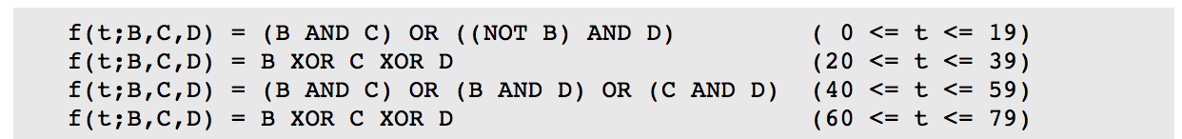
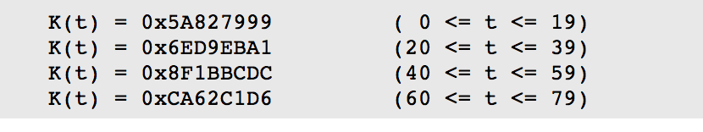
3. Prepare Processing Functions
SHA1 requires 80 processing functions:
4. Prepare Processing Constants
SHA1 requires 80 processing constant words:
Source: SHA1 Mesasge Digest Algorithm

Slide 11
5. Initialize Buffers.
SHA1 requires 160 bits or 5 buffers of words (32 bits):
H0 = 0x67452301
H1 = 0xEFCDAB89
H2 = 0x98BADCFE
H3 = 0x10325476
H4 = 0xC3D2E1F0
Source: SHA1 Mesasge Digest Algorithm

Slide 12
6. Processing Message in 512-bit blocks
The main task of SHA1 algorithm:
Loops through the padded and appended message in 512-bit blocks.
For each input block, a number of operations are performed
Source: SHA1 Mesasge Digest Algorithm

Slide 13
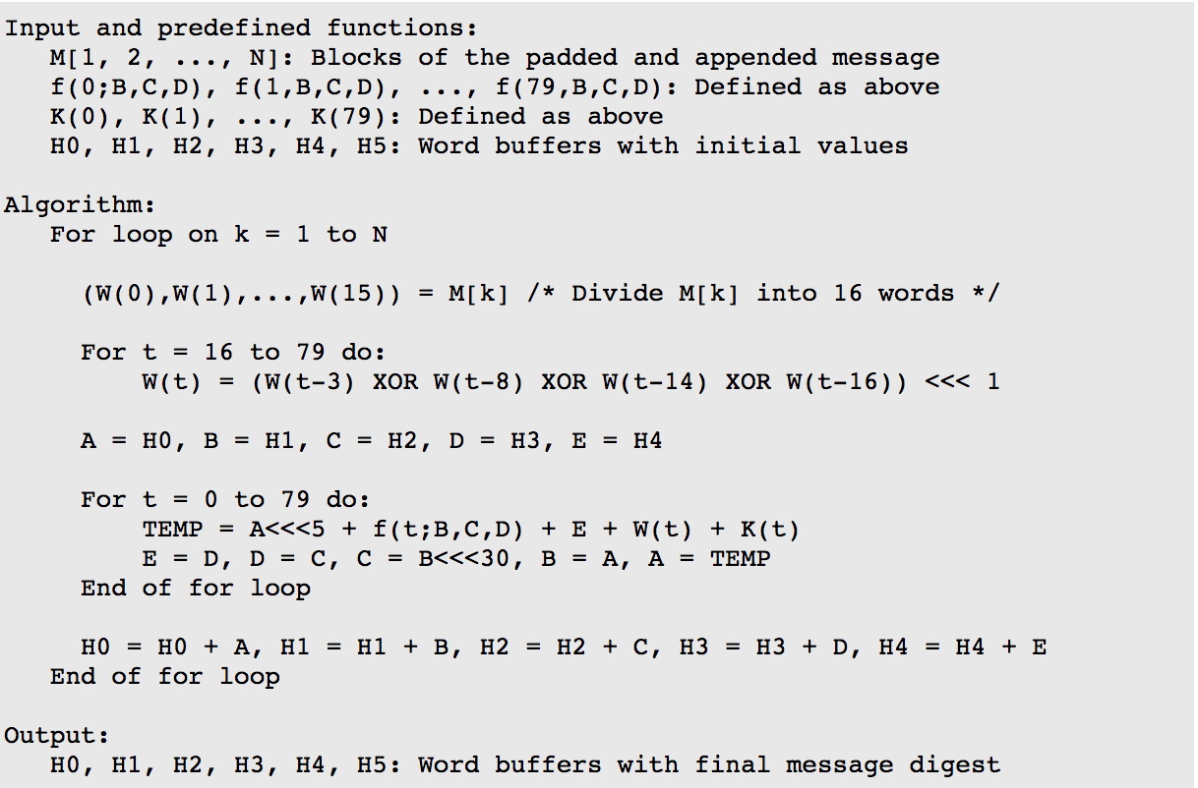
6: Pseudocode*
*Source: SHA1 Mesasge Digest Algorithm

Slide 14
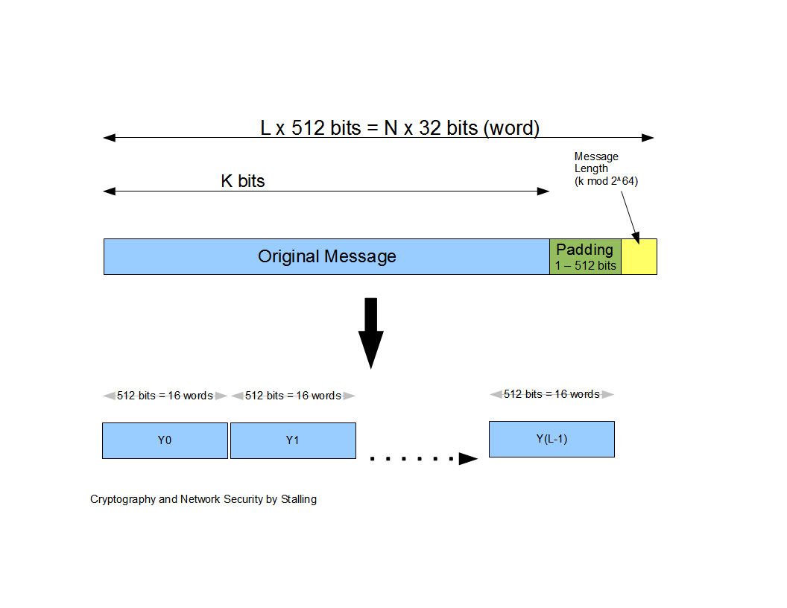

Slide 15
Other Versions
Parameter | SHA-1 | SHA-256 | SHA-384 | SHA-512
Message digest size(in bits) | 160 | 256 | 384 | 512
Message size(in bits) | <2⁶⁴ | 2⁶⁴ | 2¹²⁸ | 2¹²⁸
Block size (in bits) | 512 | 512 | 1024 | 1024
Word size (in bits) | 32 | 32 | 64 | 64
Steps in algorithm | 80 | 64 | 80 | 80

Slide 16
Security of SHA1:
1st Generated SHA-1 Collision
(based on Shattered.io + Google Security Blog on SHA1)
Notes:
The company’s researchers showed that with enough computing power — roughly 110 years of computing from a single GPU for just one of the phases — you can produce a collision, effectively breaking the algorithm. We’ve known this was possible for a while, but nobody has done it, in part because of the possible fallout.

Slide 17

What is a cryptographic hash collision?
The security or even the proper functioning of many of these applications rely on the assumption that it is practically impossible to find collisions.
A collision occurs when two distinct messages x, y that hash to the same value H(x) = H(y). A brute-force search for collisions based on the so-called birthday paradox has a well understood cost of expected calls to the hash function.
In practice, collisions should never occur for secure hash functions.
If the hash algorithm has some flaws, as SHA-1 does, a well-funded attacker can craft a collision. (example: two insurance contracts with drastically different terms)
(Shattered.io, 2017)
Notes:
The birthday paradox, also known as the birthday problem, states that in a random gathering of 23 people, there is a 50% chance that two people will have the same birthday.

Slide 18
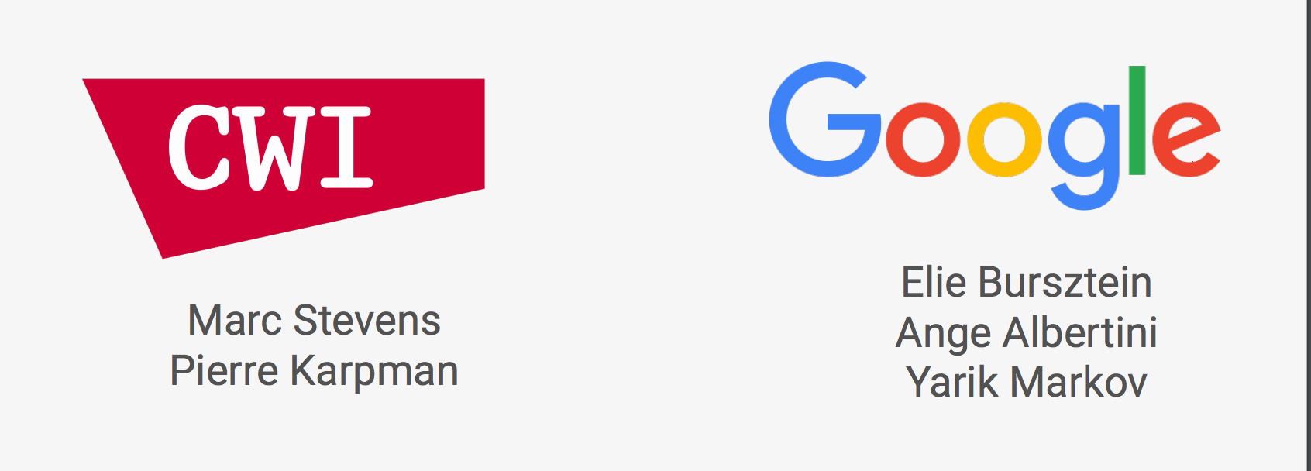
1st Generated SHA-1 Collision
The first generated SHA1 Collision was computed by
It was based on the paper published in 2013, by Marc Stevens, that outlined a theoretical approach to create a SHA-1 collision.
It involved 2 phases and was computed by using Google’s technical expertise + cloud infrastructure.
How?
Specifically crafted PDF prefix to allow the generation of two documents with arbitrary distinct visual contents, but that would hash to the same SHA-1 digest.
(Shattered.io, 2017)

Slide 19
(Shattered.io, 2017)

Slide 20

The attack basis
Identical-prefix collision attack -- a given prefix P is extended with two distinct near-collision block pairs such that they collide for any suffix S:
The computational effort spent - 263.1 SHA-1 calls
Two Near-collision attacks

Slide 21
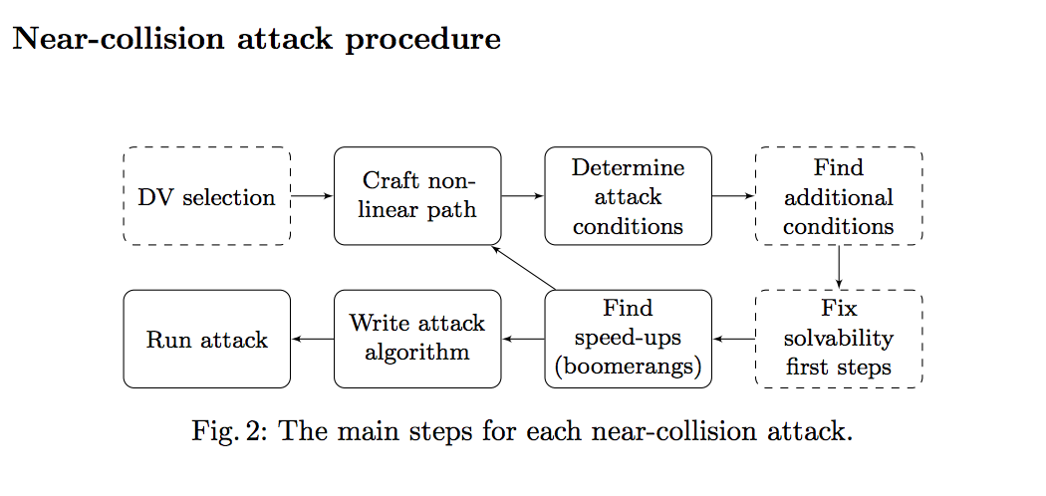
1. selection of the disturbance vector (same for both attacks); 2. construction of the non-linear differential path; 6 3. determine attack conditions over all steps; 4. find additional conditions beyond fixed diff. path for early-stop; 5. if necessary fix solvability of attack conditions over first few steps; 6. find message modification rules to speed-up collision search; 7. write the attack algorithm; 8. finally, run the attack to find a near-collision block pair.

Slide 22
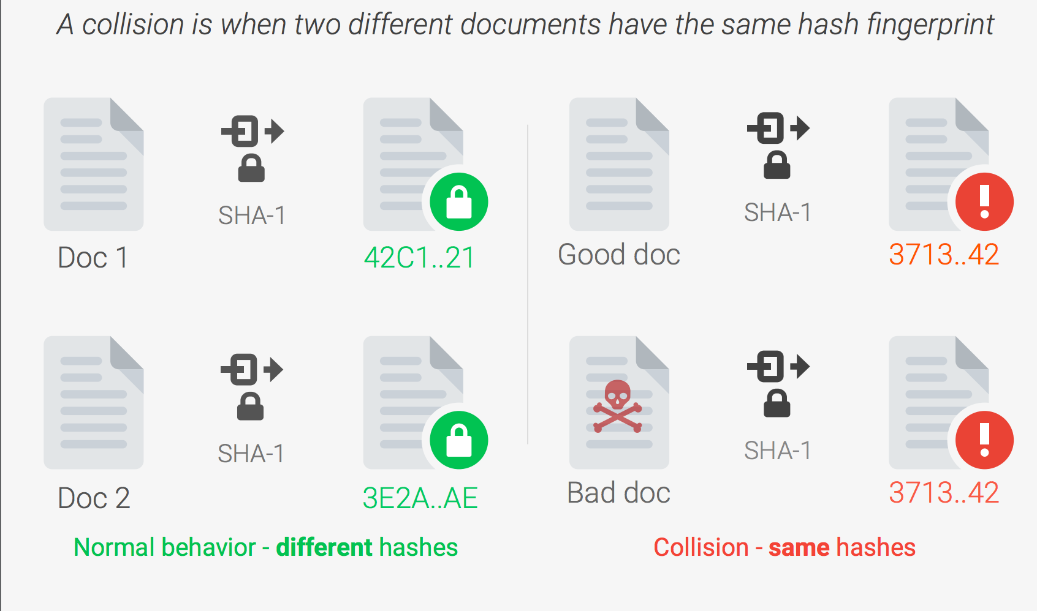
(Shattered.io, 2017)

Slide 23
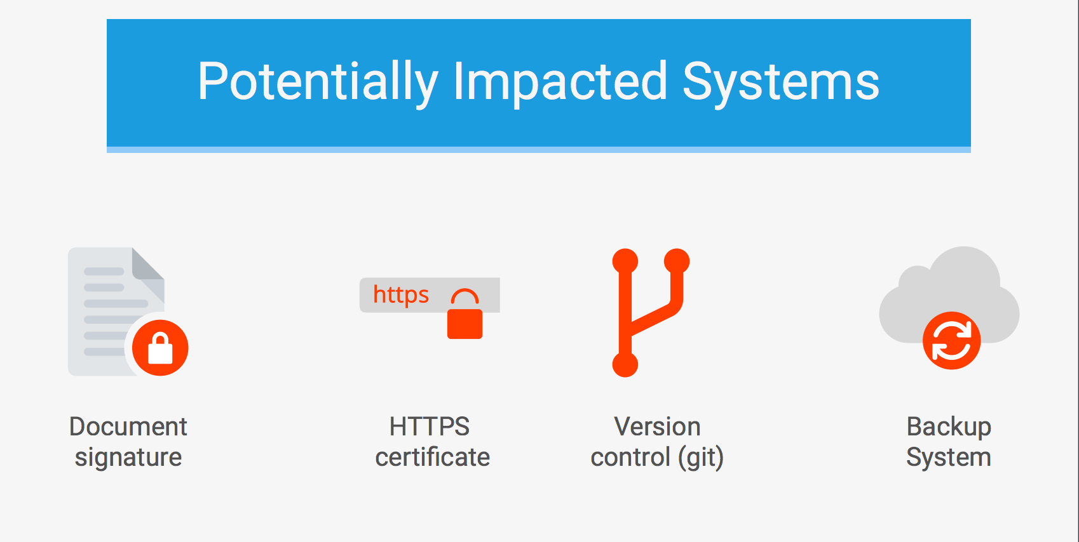
Who is affected?
Any application that relies on SHA-1 for digital signatures, file integrity, or file identification is potentially vulnerable. Including:
Digital Certificate signatures
Email PGP/GPG signatures
Software vendor signatures
Software updates
ISO checksums
Backup systems
Deduplication systems
GIT
...
(Shattered.io, 2017)

Slide 24
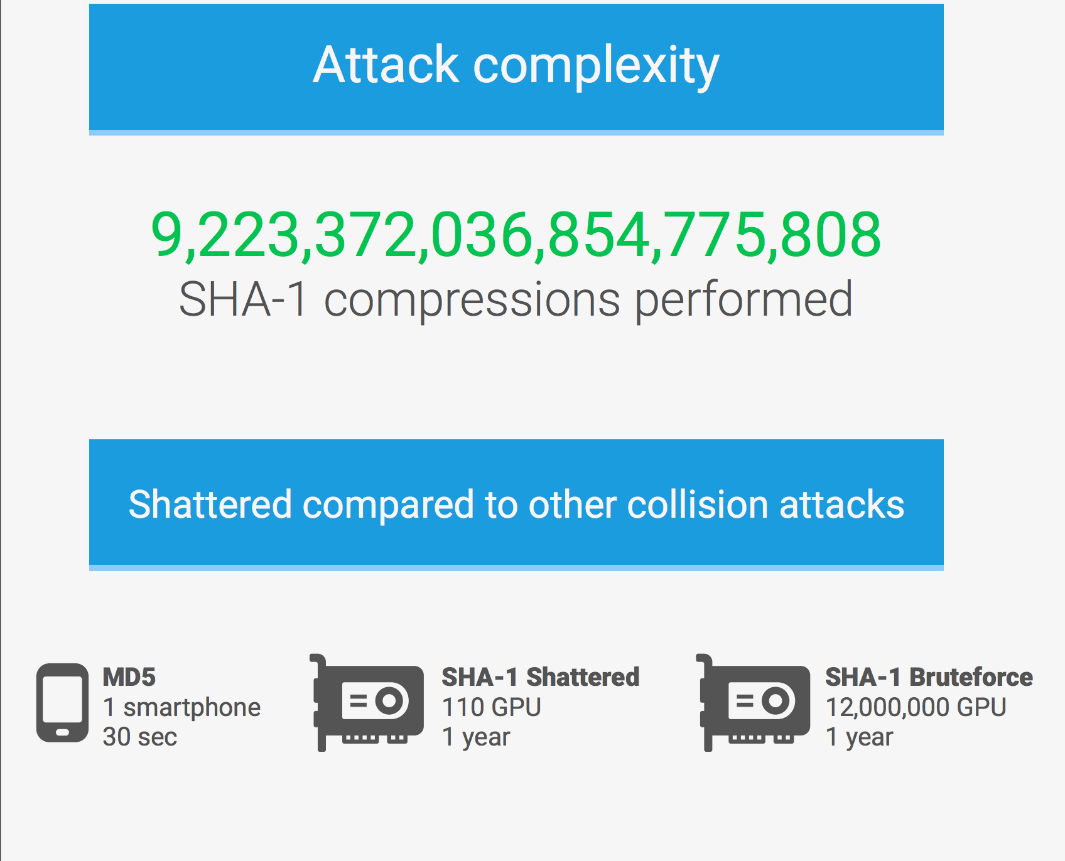
Who is capable of mounting this attack?
This attack required 9,223,372,036,854,775,808 SHA1 computations. This took the equivalent processing power as 6,500 years of single-CPU computations and 110 years of single-GPU computations.
The SHAttered attack is 100,000 faster than the brute force attack that relies on the birthday paradox. The brute force attack would require 12,000,000 GPU years to complete, and it is therefore impractical.
(Shattered.io, 2017)

Slide 25
Mitigating collision attacks for SHA1: the future
Migrating to safer cryptographic hashes such as SHA-256 and SHA-3.
Using the detection systems (such as shattered.io) to test the PDFs.
Using collision detection code
Any Certification Authority abiding by the CA/Browser Forum regulations is not allowed to issue SHA-1 certificates anymore.
Chrome and Firefox browsers have deprecated SHA1
(Shattered.io, 2017)

Slide 26
Thank you for your attention! - Q&A

Slide 27
Bibliography
Stallings, William, Cryptography and Network Security, Prentice Hall, 1999.
(n.d.). Retrieved May 01, 2017, from http://www.herongyang.com/Cryptography/SHA1-Message-Digest-Algorithm-Overview.html
C. (2017, April 11). SHA: Secure Hashing Algorithm - Computerphile. Retrieved May 03, 2017, from https://www.youtube.com/watch?v=DMtFhACPnTY
(n.d.). Retrieved May 02, 2017, from https://shattered.io/
Announcing the first SHA1 collision. (2017, February 23). Retrieved May 01, 2017, from https://security.googleblog.com/2017/02/announcing-first-sha1-collision.html
Cryptographic Hash Functions. (n.d.). SpringerReference. doi:10.1007/springerreference_64663
Schneier on Security. (2004, August 19). Retrieved May 03, 2017, from https://www.schneier.com/essays/archives/2004/08/cryptanalysis_of_md5.html
SHA1 and other hash functions online generator. (n.d.). Retrieved May 01, 2017, from http://www.sha1-online.com/
Schneier, Bruce, “Opinion: Cryptanalysis of MD% and SHA: Time for a new standard”, Computer World, August 2004.
The first collision for full SHA-1, Marc Stevens, Elie Bursztein, Pierre Karpman, Ange Albertini, Yarik Markov, preprint, 2017. (PDF).
Speeding up detection of SHA-1 collision attacks using unavoidable attack conditions, Marc Stevens, Dan Shumow, preprint, 2017. (PDF).

